Slide 1
Problem Statement Title: Personalized Product Recommendations
Team Name: Shiva CSM BITS

Slide 2

Team members details
Team Name | Shiva CSM BITS
Institute Name/Names | Balaji Institute of Technology and Science, Warangal
Team Members > | 1 (Leader) | 2 | 3
Name | Shiva kumar Chindam
Batch | 2022-2025

Slide 3
Deliverables/Expectations for Level 2 (Idea + Code Submission)
I AM SUBMITTING:
Source code
Data storage and Data validation xlsx.file(which will act as a Data Base to our Application)
Solution statement approach Block Diagram (xlsx.file)
NOTE:Due to uploading file size limit, I am sending a zip file which have all the files as individual zips, before execution kindly extract each file.
For all Original files, Runnable JAR file(Which contains complete code)
and Dependencies of my applications(POI jars and Java8setup.exe) please go through below Google drive link.
Link:https://drive.google.com/drive/folders/13WkSGUjbT0ssgvGiCUOjoWnKzt0NZ8ib

Slide 4
Glossary
DB Stands Data base.

Slide 5
Use-cases
When a user visits the Application, if user want to register for new account then user has to provide their details by using sign up.
If user want to login to his/her account then user has to provide their details by using login.
After login successfully , the user has to select the product which is available in the product _list or Cate log.
Based on the product selected, available respective brands will be displayed.
After selecting product and brand , clicking on submit it will save the product and brand as user preferences
System analyzes All the User’s Number of searches , and their preferences.
Based on this information, the system generates real-time rankings for products and user preferences for all the individual users.
If user want to switch to another account then by using Log out user will back to the Login Page.

Slide 6
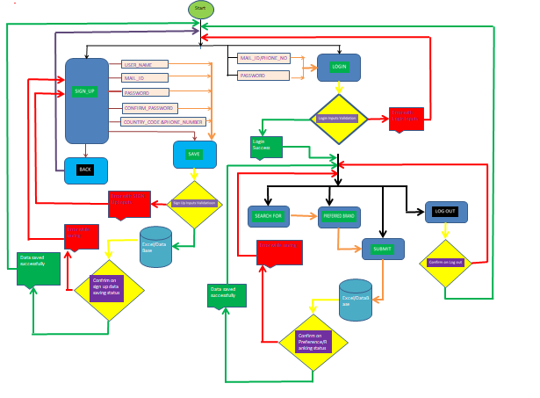
Solution statement/ Proposed approach

Slide 7
Limitations
Here I do not have any database so I am using excel file(‘.xlsx’ file) as a database for my application.(we have to consider entire file as a DB and each sheet as a Table).
In my application I have set up a validation for user mail id format and it is sample: xxxx@gmail.com , it will won’t allow other than g-mail ids.
Solution for above listed points
For point 1, if we have DB details then We can enhance the code and integrate to DB. Application will support and works fine.
For point 2, we can change/enhance our code to allow some more accounts like outlook.
Applications will support and works fine.

Slide 8
Future Scope
We can easily integrate my code to DB, hence we can increase the performance and efficiency.
We have added many validations for User inputs(like:- User name, mail id ,password , confirm password and Phone Number), so it will help and act as real time application.
Here, we are collecting user personal data (like:-email id and phone number),Hence by using Ranking System we can send recommended product links through e-mail or SMS to the users.

Slide 9
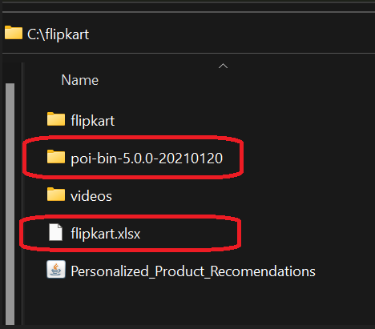
Instructions to Run The Code
I have submitted dependencies(download from provided drive link) and Data managed xlsx.file , source code and runnable jar (download from provided drive link).
To execute my code or runnable jar file, dependencies should present in below path.
Path:C:\flipkart

Slide 10
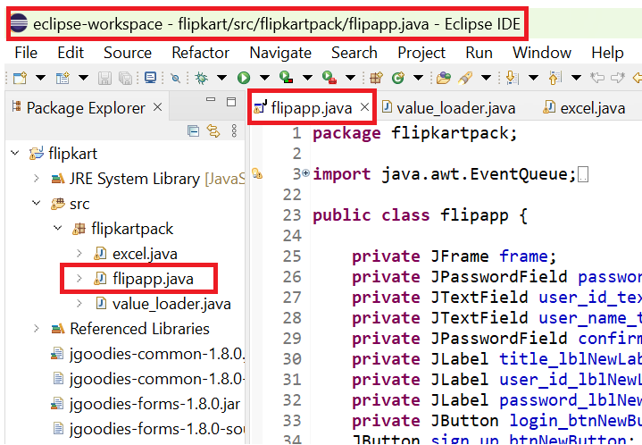
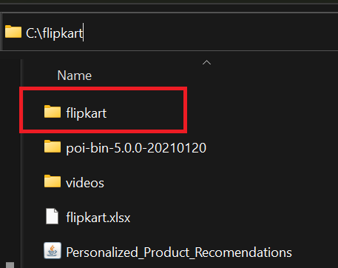
3. Add below highlighted folder(which contains complete code) as Java Project to Eclipse.
And run below highlighted class to see our Ranking system application.

Slide 11
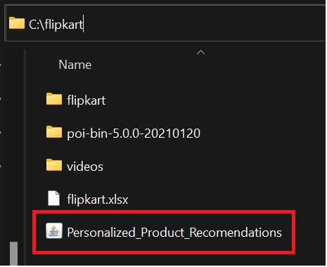
4.If we want to run the Executable jar file(with complete code) instead of running the code in Eclipse. Please run below highlighted file.

Slide 12
Thank You

